Slide 1
SC1015 Mini Project
Lego Dataset By:
Tan Yan Kai Noel U2322141K
Goh Bo Jun, Issac (Wu Bojun) U2321547G

Slide 2
Table of contents
01
02
03
04
Introduction
Exploratory Analysis
Machine Learning Model
Conclusion

Slide 3
01
Introduction

Slide 4
Lego Market in 2023
Financial growth stagnates as revenue only grows by 2% in 2023
First time LEGO’s net profit has declined since 2017.
Thankfully, consumer sales grew by 4% in the U.S. and Central and Eastern Europe
Popular themes and collaborations such as:
Lego Star Wars
Lego Ninjago
Lego Harry Potter

Slide 5
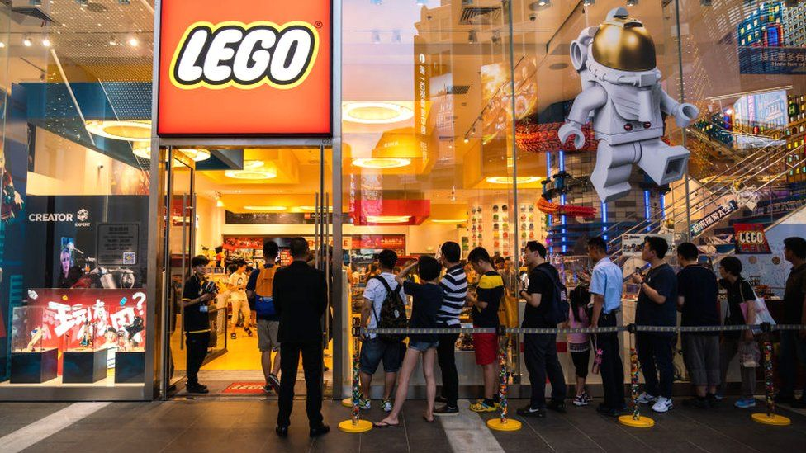
Problem Formulation
What factors can LEGO consider in their designs to generate optimal sales revenue?

Slide 6
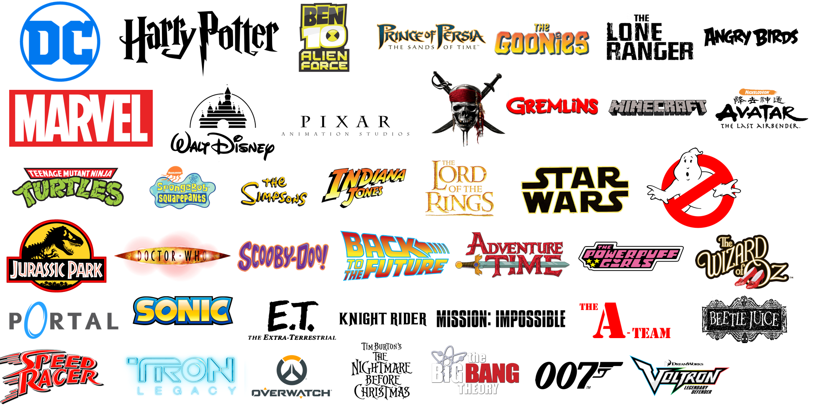
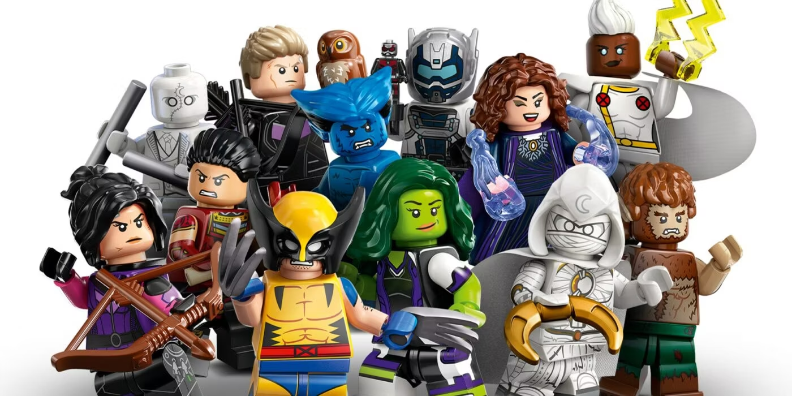
Problem Formulation
What predictive variables can be analyzed to predict the set rating of a LEGO set?

Slide 7
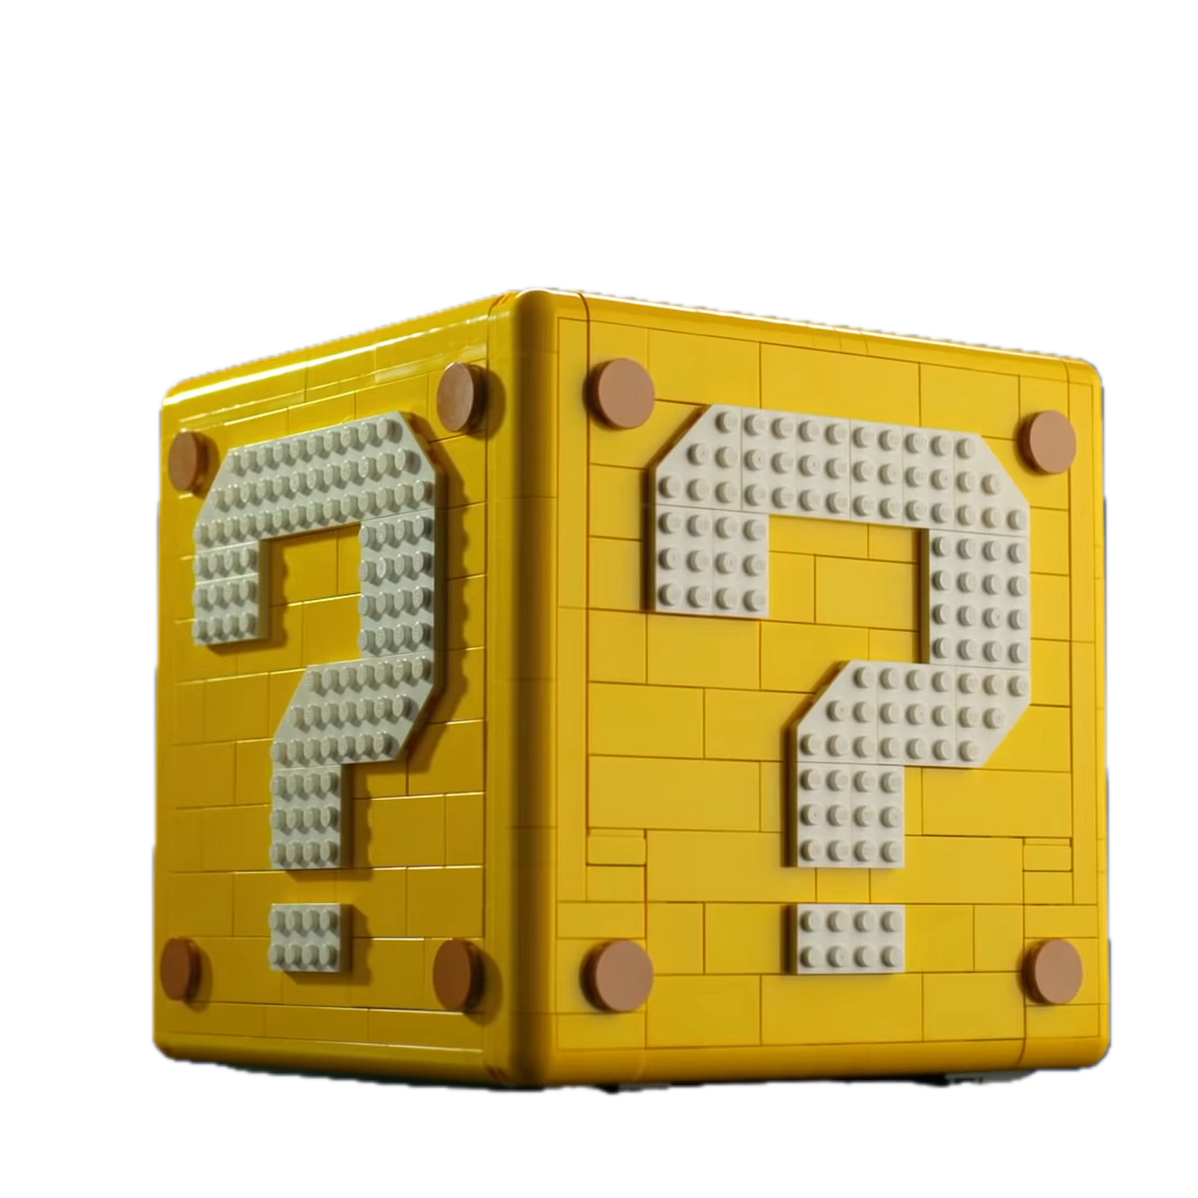
Problem Formulation
Why predict the set rating??
Understand consumer satisfaction and perception of product
Identify potential issues or area for improvements
Optimize product portfolio and strengthen customer relationship

Slide 8
02
Exploratory Analysis

Slide 9
Predictive Variables for set rating
Theme
Minifigures
Pieces
USD_MSPR
Availability
Lego Batman
Lego Harry Potter
Number of exclusive minifigures
Number of pieces per set
Retail price in USD
Exclusivity of set

Slide 10
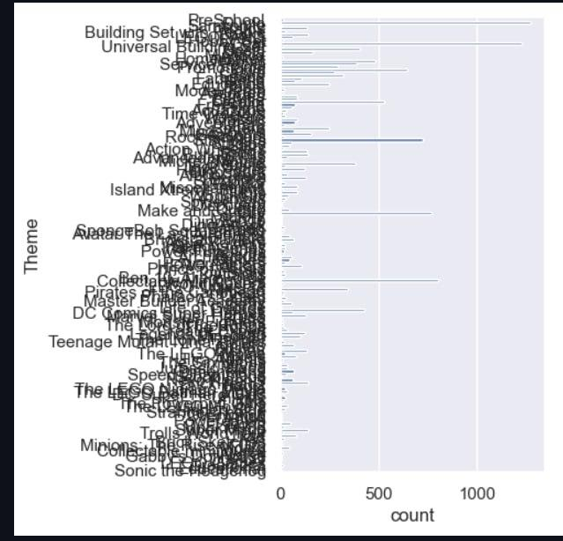
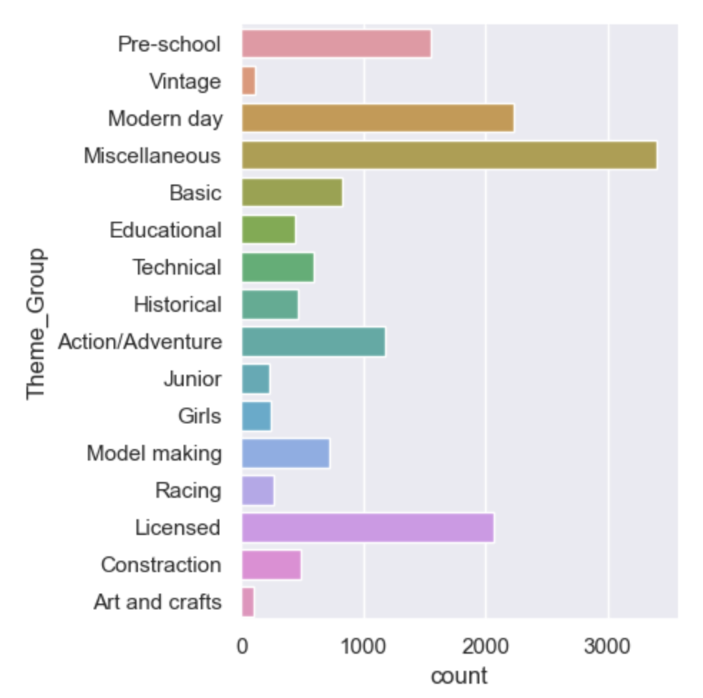
Set Theme
Before: Using specific set theme
After: Using parent set theme

Slide 11
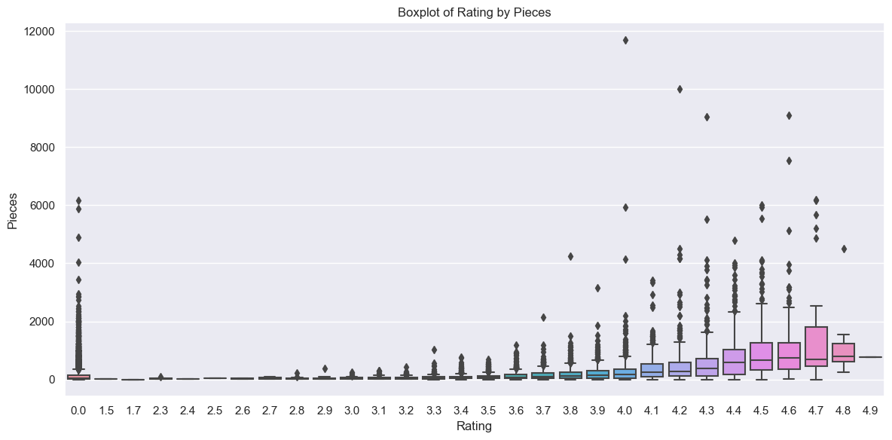
Number of pieces

Slide 12
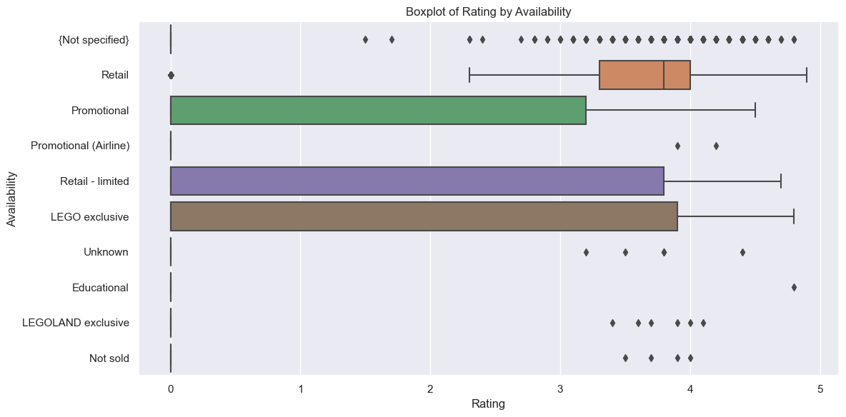
Availability

Slide 13
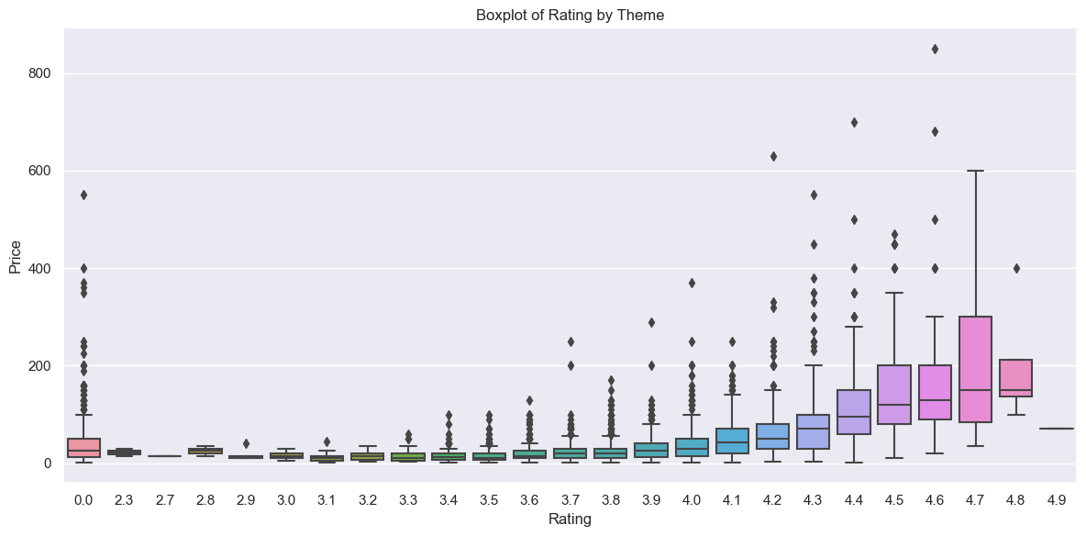
USD_MSRP

Slide 14
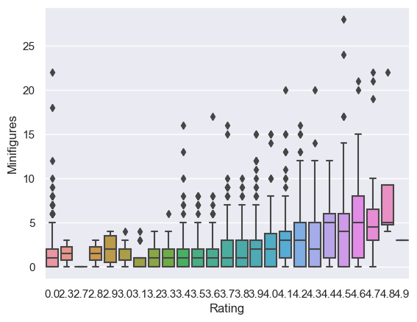
Minifigurines

Slide 15
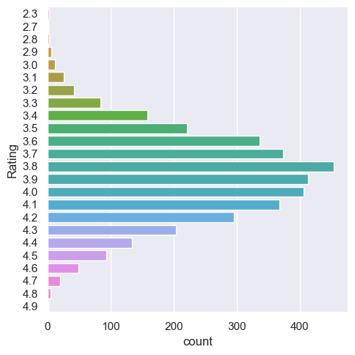
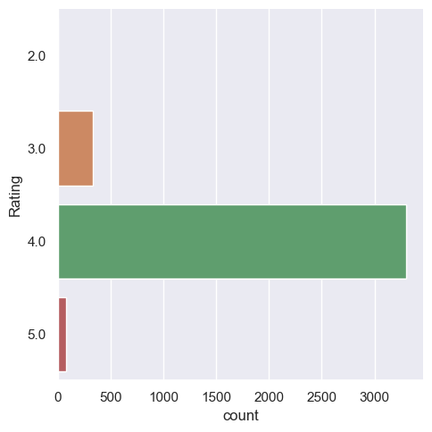
Analyzing the response variable
Before: Non-rounded off Set Rating
After: Rounded-off Set Rating

Slide 16
Cleaning the data
Remove outliers for pieces and USD_MSRP
Remove Availability from the model
01
02
03
04
Removing and replacing empty spaces and Null values
Reclassify and balance Set Ratings

Slide 17
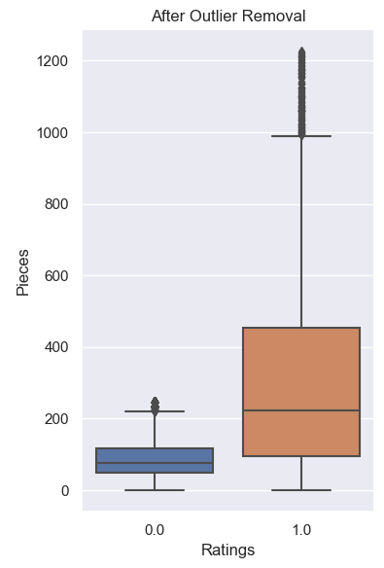
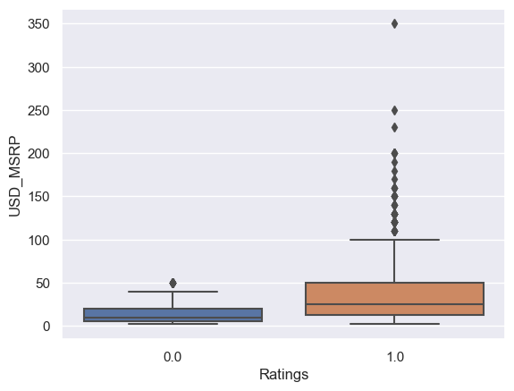
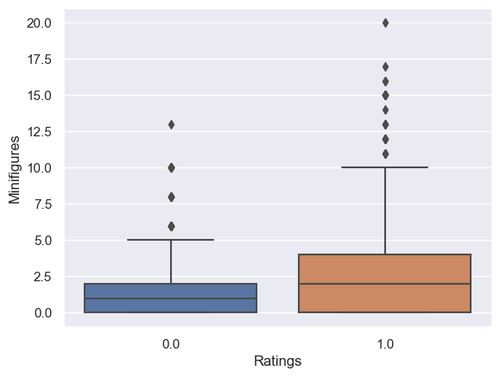
CleANING THE DATA
Removing Outliers

Slide 18
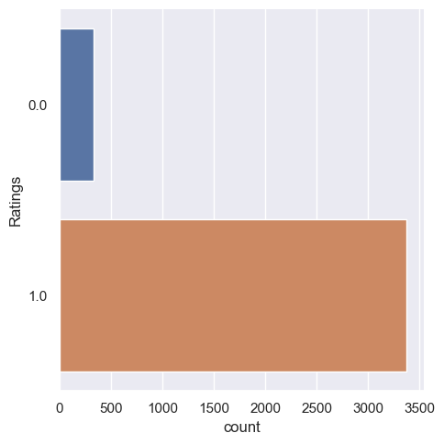
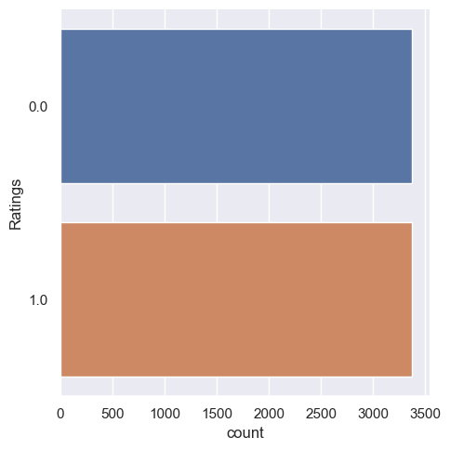
CleANING THE DATA
Before: Non-balance Set Rating
After: Balanced Set Rating

Slide 19
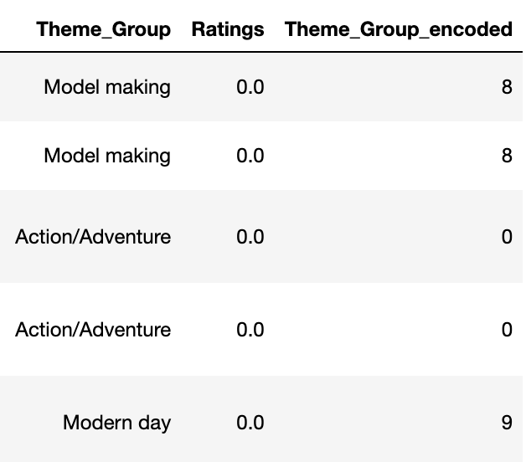
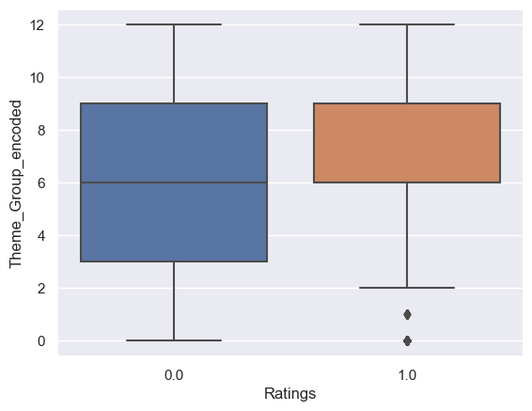
CleANING THE DATA
Encoding the string variable “Theme”

Slide 20
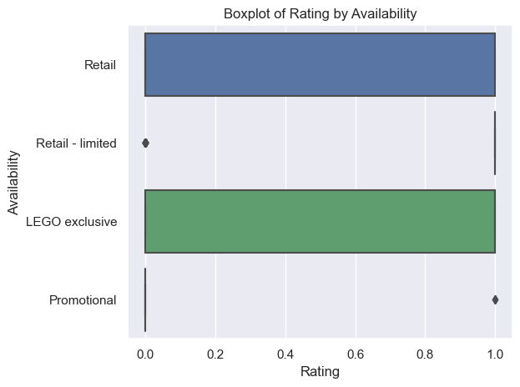
CleANING THE DATA
Removing the variable ‘Availability’

Slide 21
03
MACHINE LEARNING
Decision Tree
Random Forest
GridSearch

Slide 22
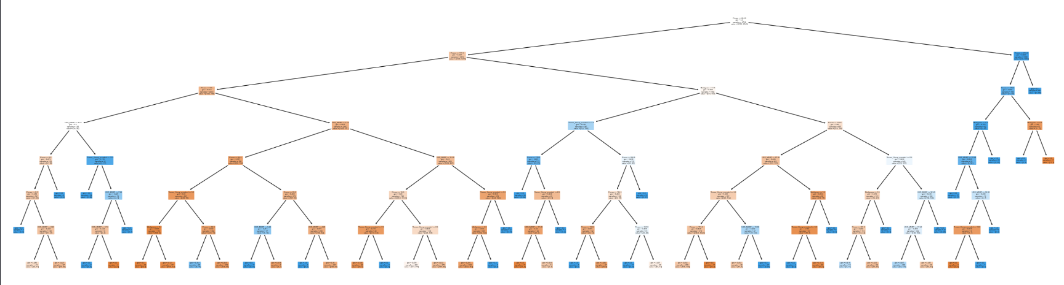
Decision tree
A decision tree is used to classify the categorical response variable (Ratings) using the other predictors.
The classification accuracy was above 75%
False negative rate was above 35%

Slide 23
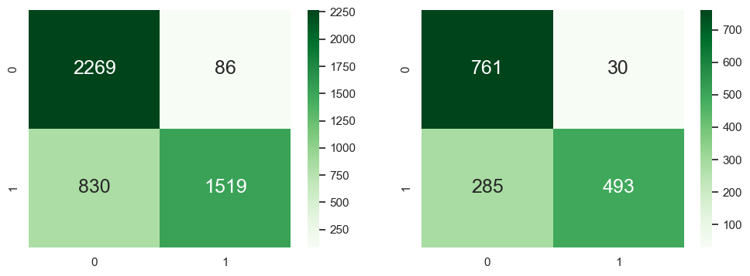
Decision tree: confusion matrix
Goodness of Fit of Model: Train Dataset
Classification Accuracy : 0.8052721088435374
True Negative Rate : 0.9634819532908705
True Positive Rate : 0.6466581524052788
False Negative Rate : 0.35334184759472115
False Positive Rate : 0.03651804670912951
Goodness of Fit of Model: Test Dataset
Classification Accuracy : 0.7992351816443595
True Negative Rate : 0.9620733249051833
True Positive Rate : 0.6336760925449871
False Negative Rate : 0.36632390745501286
False Positive Rate : 0.03792667509481669

Slide 24
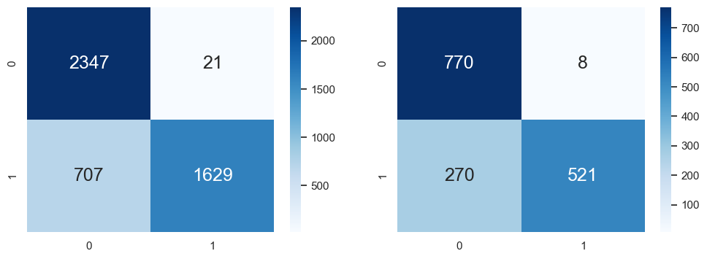
Random forest: confusion matrix
Goodness of Fit of Model: Train Dataset
Classification Accuracy : 0.8452380952380952
True Negative Rate : 0.9911317567567568
True Positive Rate : 0.697345890410959
False Negative Rate : 0.3026541095890411
False Positive Rate : 0.008868243243243243
Goodness of Fit of Model: Test Dataset
Classification Accuracy : 0.822817080943276
True Negative Rate : 0.9897172236503856
True Positive Rate : 0.6586599241466498
False Negative Rate : 0.3413400758533502
False Positive Rate : 0.010282776349614395
The classification accuracy increase to above 80%
False negative rate decreased but still above 30%

Slide 25
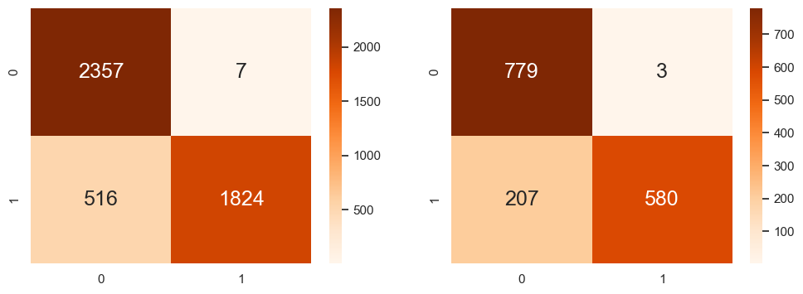
Post-Gridsearch: confusion matrix
Goodness of Fit of Model: Train Dataset
Classification Accuracy : 0.8888180272108843
True Negative Rate : 0.9970389170896785
True Positive Rate : 0.7794871794871795
False Negative Rate : 0.2205128205128205
False Positive Rate : 0.002961082910321489
Goodness of Fit of Model: Test Dataset
Classification Accuracy : 0.8661567877629063
True Negative Rate : 0.9961636828644501
True Positive Rate : 0.7369758576874206
False Negative Rate : 0.2630241423125794
False Positive Rate : 0.0038363171355498722

Slide 26
04
Conclusion

Slide 27
Learning outcomes:
Using different machine learning functions
Random forest
Cross Validation GridSearch
New plotting function plotly
More interactive
Class Balancing
Oversampling method

Slide 28
Data driven insights:
More pieces
Making the sets more technical can enable the designers to put in more pieces into each set
Create limited edition sets aimed at adult enthusiasts and collectors that feature extremely high piece counts and sophisticated designs.
More minifigures
New theme sets with emphasis on minifigures

Slide 29
Thanks!

Slide 30
References
Did you like the resources on this template? Get them for free at our other websites:
photos
Father's day dad and son playing with lego
Front view cute kid playing with lego
Non binary kids playing with a colorful game
Vectors
Flat under construction template

